Slide 1
Job Match
Job Match
Sesha Sriram Kashyap Karamcheti – Y00873793
Dharan Muppidi – Y00868519
Gopichand Jinka – Y00862153
Youngstown State University
CSCI 6991 - Data Engineering Capstone
Dr. Feng Yu
Under the guidance of – Robert Gilliland
11/26/2025

Slide 2
Table of contents
02
03
01
04
Introduction
System Architecture
Technical Implementation
05
06
Discussion
Conclusion
Testing and Validation
07
Future enhancement

Slide 3

Introduction
The platform bridges the gap between job seekers and employers.
Utilizes machine learning, Python, and cloud computing for efficient job matching.
Focus on data security with robust protection against data breaches and identity theft.

Slide 4

System Architecture Overview
MVC Model
Django Framework
Frontend
Modular, scalable, and secure platform using Model-View-Controller (MVC) design pattern.
Django framework with cloud deployment (AWS/Google Cloud).
HTML, CSS, JavaScript with Bootstrap for a responsive UI.

Slide 5
Backend Overview
MVT
Models
Developed using Django's Model-View-Template (MVT) pattern.
Contains the tables migrated to the database for keeping records and data of various users
User profiles and job listings
Machine Learning Models
User profiles contain personal information, skills, and preferences.
Job listings include job title, required skills, and salary range.
Machine learning models for job matching based on TF-IDF Vectorization and Cosine Similarity

Slide 6
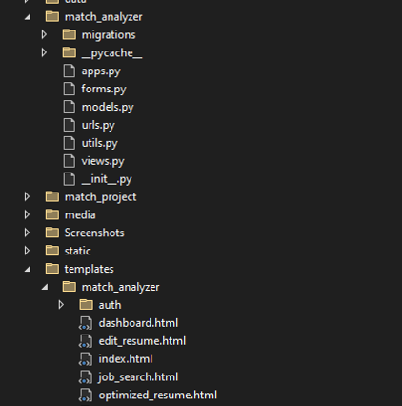
Security Architecture
Two-Factor Authentication (2FA) for user account security.
AES-256 Encryption for secure data storage and transmission.
Role-Based Access Control (RBAC) ensuring appropriate data access for each user role.
All communication secured using HTTPS with SSL/TLS encryption

Slide 7
Technical Implementation Overview
JOB MATCH
Backend: Django framework, PostgreSQL database.
Job Matching Algorithm: TF-IDF vectorization, Cosine Similarity, and ranking.
Skill Assessments: Integrated coding challenges and behavioral tests for various roles.
Security Features: 2FA, AES-256 Encryption, JWT Tokens.

Slide 8
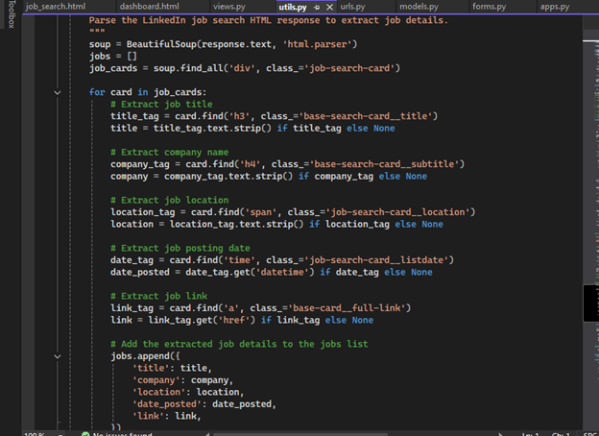
Job Matching Algorithm
TF-IDF Vectorization converts job descriptions and user profiles into numerical vectors.
Cosine Similarity measures the match between job descriptions and user profiles.
Ranking and filtering ensure only relevant job listings are shown based on user preferences.

Slide 9
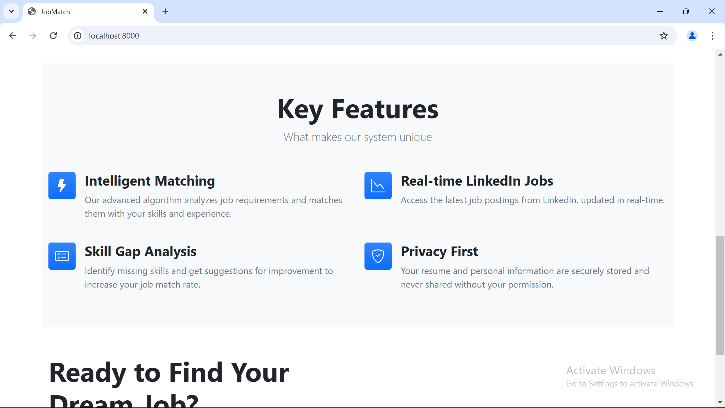
Skill Assessment Module
Technical Roles: Coding challenges automatically graded with instant feedback.
Non-Technical Roles: Behavioral assessments with Likert scale scoring.
Feedback: Candidates receive immediate feedback, which can be shared with employers.

Slide 10
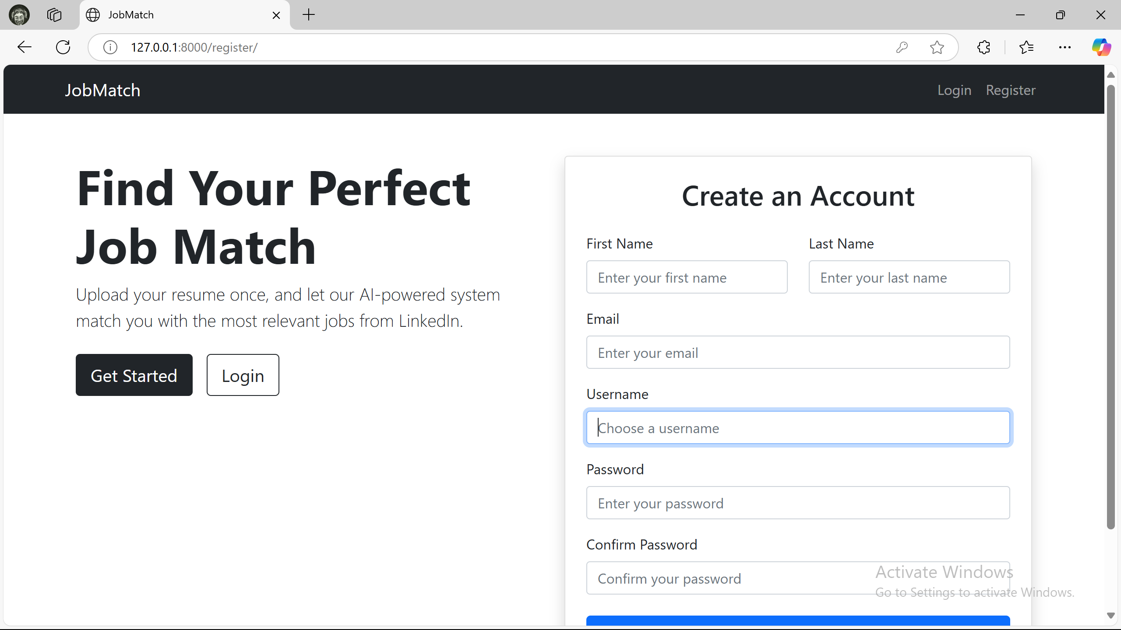
Security Features
User Authentication via Django’s system with extended 2FA.
AES-256 encryption for sensitive data protection.
JWT tokens for secure API authentication.
Regular security audits and penetration testing.

Slide 11
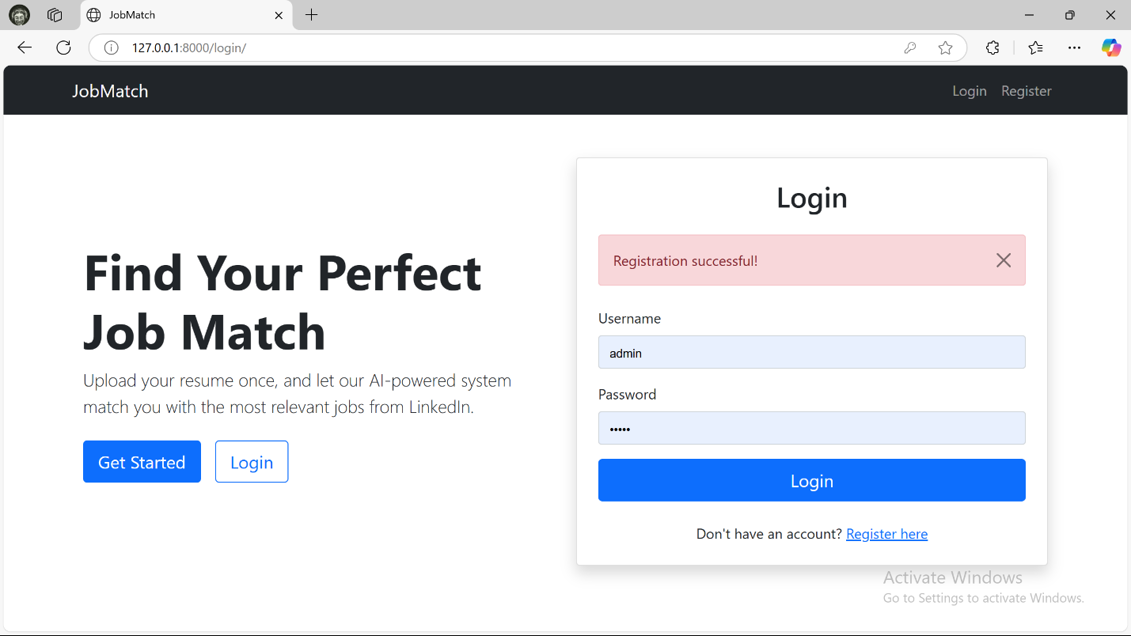
Testing and Validation
Unit Testing: Ensures core features like job matching and user authentication work as expected.
Integration Testing: Ensures smooth interaction between platform components.
Performance Testing: Load testing showed that the system can handle high traffic.
Security Testing: Focuses on ensuring platform protection against vulnerabilities.

Slide 12
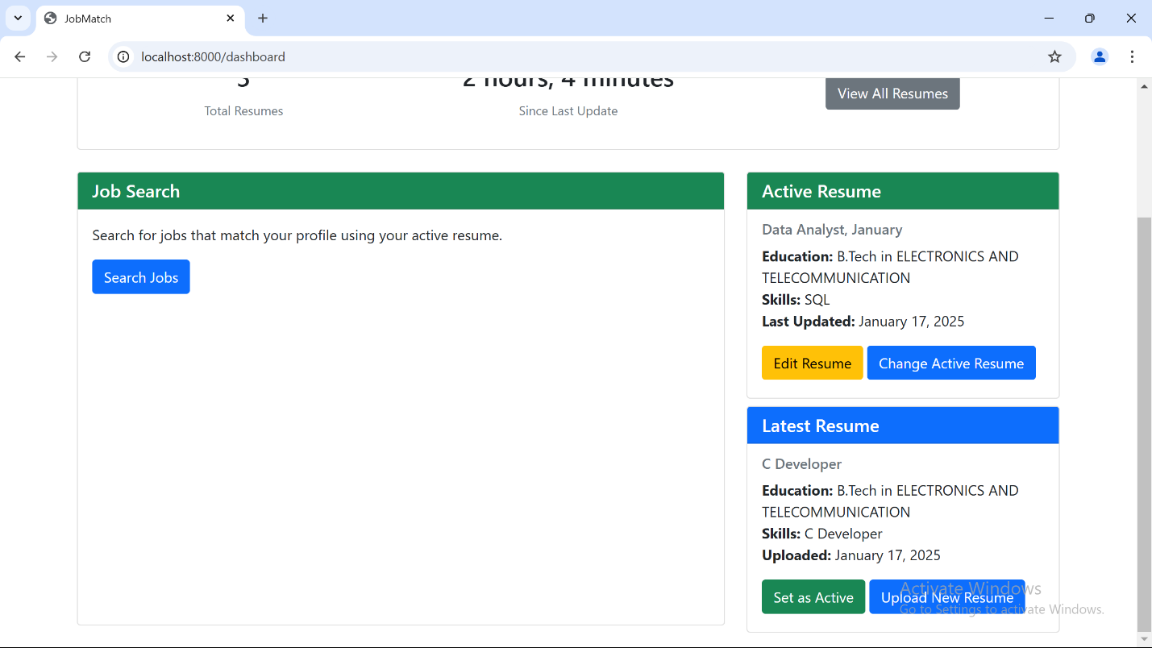
Discussion - Achievements
Accurate job matching using machine learning algorithms.
Real-time skill assessment to verify candidate qualifications.
Strong security measures with AES-256 encryption and 2FA.
Scalability and flexibility through cloud-based infrastructure.

Slide 13
Key Strengths of the Platform
Accurate Job Matching: Machine learning-based algorithm for better job recommendations.
Real-Time Skill Assessment: Verifies candidate skills through coding and behavioral assessments
Robust Security: Uses AES-256 encryption and 2FA for data protection.
Scalability: Cloud-based infrastructure ensures future growth.

Slide 14
Challenges During Development
Data Privacy and Compliance: Ensuring GDPR compliance for user data protection.
Matching Accuracy for New Users: Improved over time with more data.
System Performance Under Load: Optimized for peak usage with load balancing.

Slide 15
Conclusion
The platform offers an intelligent, secure, and scalable solution for job seekers and employers.
Machine learning improves job matching, and strong security features ensure user data protection.
Future enhancements will include AI, mobile app development, and broader skill assessments.

Slide 16
Future Enhancements
Advanced AI Integration: Incorporating neural networks and NLP for smarter job matching.
Mobile Application Development: Expanding to mobile platforms for better accessibility.
Expanded Skill Assessment Modules: Adding more tests for diverse job roles.
AI-Powered Resume Parsing: Automating resume analysis for faster job matching.

Slide 17
Thanks!
Job Match
20xx

